Slide 1

AI-Powered Workout Trainer: Enhancing Wellness and guidance Through Posture Recognition
Submitted in the partial fulfillment for the award of the degree of
BACHELOR OF ENGINEERING
IN
COMPUTER SCIENCE WITH SPECIALISATION IN IOT
Submitted by:
Inderjeet Singh (22BIT70061)
Rishabh Kumar (22BIT70062)
Under Supervision of Dr. Abhishek Tiwari
Kishlay (22BIT70053)
Ruman (22BIT70060)
Department of AIT-CSE
DISCOVER . LEARN . EMPOWER

Slide 2
Outline
Introduction to Project
Problem Formulation
Objectives of the work
System Architecture
Machine Learning Models
System Integration
Testing and Performance Results
Future Scope
Conclusion
2

Slide 3

Introduction to Project
Modern fitness routines often lack real-time, personalized feedback, leading to inefficiencies and injury risks. Traditional methods rely on trainers or self-assessment, which are error-prone, costly, and inaccessible. AI-powered posture recognition systems address these gaps by offering real-time biomechanical analysis, personalized guidance, and data-driven insights, democratizing access to expert- level training. This project leverages computer vision and machine learning (ML) to create an intelligent workout assistant that enhances exercise safety and effectiveness.

Slide 4
Problem Formulation
Key Challenges:
Inconsistent self-assessment during workouts.
Limited access to professional trainers.
High risk of injuries due to improper form (e.g., rounded backs during deadlifts).
Generic fitness apps unable to adapt to individual biomechanics.
Research Question:
How can AI-driven posture recognition systems improve exercise form accuracy and reduce injury risks in real time?
4
-

Slide 5
Objectives of the Work
Develop a pose estimation model to track 20+ body keypoints (e.g., joints, spine).
Classify exercises (e.g., squats, planks) and detect form deviations using ML.
Generate real-time corrective feedback via audio/visual cues.
Design adaptive workout plans based on user progress and physical metrics.
Ensure low-latency performance (<200 ms) for seamless user experience.
5

Slide 6
System Architecture
Input Layer: RGB camera or smartphone video feed.
Posture Recognition Module:
MediaPipe Pose for keypoint extraction.
CNN-based model for exercise classification (e.g., ResNet-50,Posnet).
Feedback Engine:
LSTM to analyze temporal movement patterns.
LLM (e.g., GPT-4) to generate natural-language feedback.
User Interface: Mobile/web app displaying metrics, alerts, and progress dashboards.
Data Storage: Cloud-based user profiles storing workout history and performance metrics.

Slide 7
Machine Learning Models
Pose Estimation: MediaPipe (2D) or HRNet (3D) for joint tracking10,15.
Exercise Classification:
CNN for spatial feature extraction (e.g., EfficientNet).
LSTM to capture temporal dependencies in movement sequences12.
Form Deviation Detection:
Threshold-based angle analysis (e.g., knee flexion < 90° triggers alerts).
Siamese networks to compare user pose with ideal templates3.
7

Slide 8

System Integration
Hardware-Software Synergy:
Camera input processed via OpenCV.
Real-time inference on edge devices (e.g., TensorFlow Lite for mobile).
APIs:
Integration with wearables (e.g., Apple Watch for heart rate synchronization).
Firebase for user authentication and data storage.
Feedback Loop: User corrections are logged to refine adaptive workout plans.

Slide 9
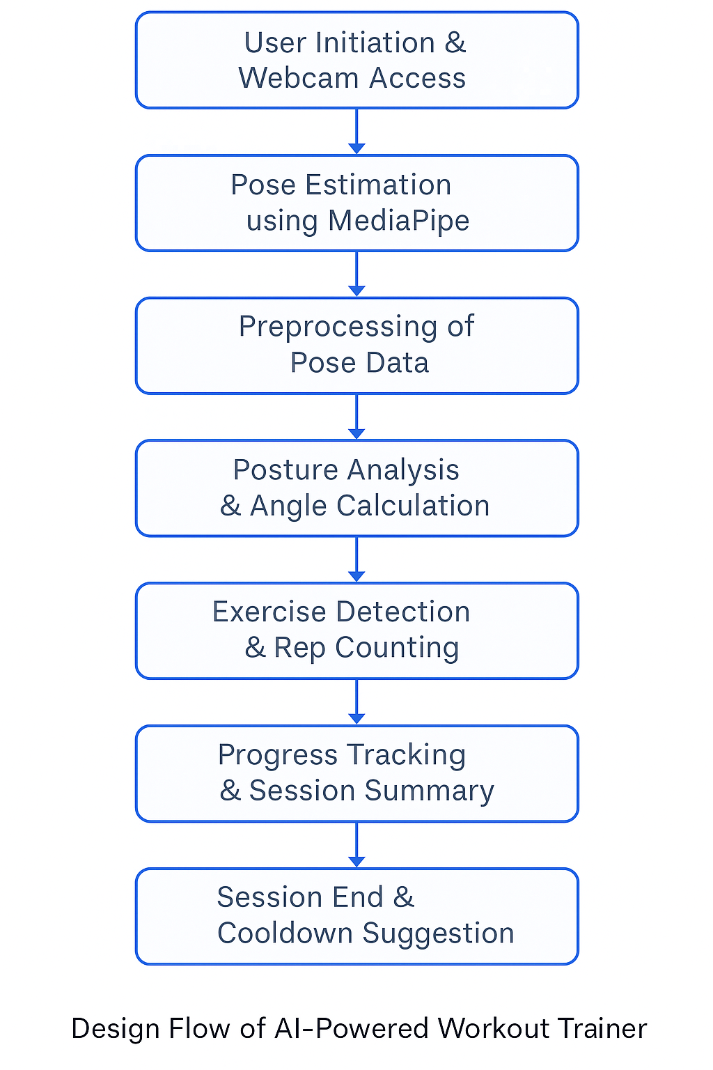
FlowChart

Slide 10
Testing and Performance Results
Datasets: COCO-Keypoints, Yoga-82, and custom exercise videos.
Metrics:
Accuracy: 94% exercise classification (F1-score).
Latency: 150 ms per frame on mid-range smartphones.
User Satisfaction: 89% reported improved confidence in form (pilot study).
Failure Cases: Poor lighting or occlusions reduced accuracy to 78%, addressed
via data augmentation.
9

Slide 11
Future Scope
1. Multimodal Analysis: Integrate voice commands and EMG sensors for
muscle activation tracking.
3D Pose Estimation: Kinect or LiDAR for depth-aware feedback.
Rehabilitation Focus: Expand to post-surgery/therapeutic guidance.
exercise
Gamification: VR/AR integration for immersive workout experiences.
Global Accessibility: Offline mode for regions with limited internet access.

Slide 12
Conclusion
AI-powered posture recognition systems redefine fitness training by merging
precision, personalization, and accessibility. This project demonstrates the feasibility of real-time form correction, reducing injury risks and enhancing workout efficacy. As AI models and hardware evolve, such systems will bridge the gap between professional coaching and at-home fitness, empowering users to achieve their wellness goals safely.

Slide 13
THANK YOU
12

